Slide 1
PCS QAM Project 2025
Aditya Rajesh

Slide 2
Problem Statement
Design a 16-QAM system using two pulse shapes (square and sinc) for baseband modulation.
Implement matched filtering and symbol detection.
Add AWGN for SNRs in [0, 3, 7] dB and evaluate BER.

Slide 3
Applications
Wi-Fi (802.11 standards)
Most Wi-Fi networks (like 802.11ac and 802.11ax) use 64-QAM, 256-QAM, or even 1024-QAM
Higher-order QAM = higher speeds (assuming strong signal).
Cellular Networks (4G, 5G)
LTE and 5G use QAM for downlink and uplink modulation
4G can go up to 64-QAM, and 5G can go up to 1024-QAM
Cable Modems (DOCSIS)
Your home internet via coax uses 256-QAM or higher for downstream data
Digital TV and Satellite
Digital cable TV and satellite use QAM for transmitting compressed video data
DSL / Broadband over Phone Lines
QAM is used in ADSL/VDSL to transmit high-speed internet over copper lines

Slide 4
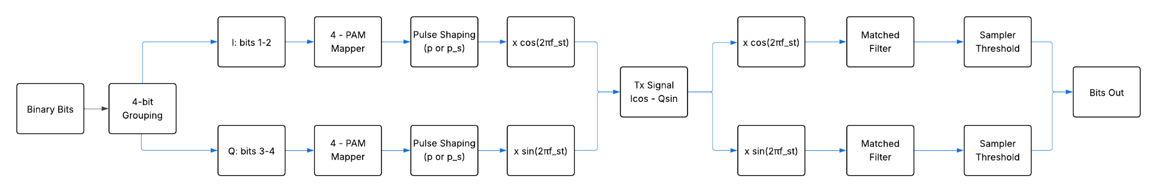
Block Diagram

Slide 5
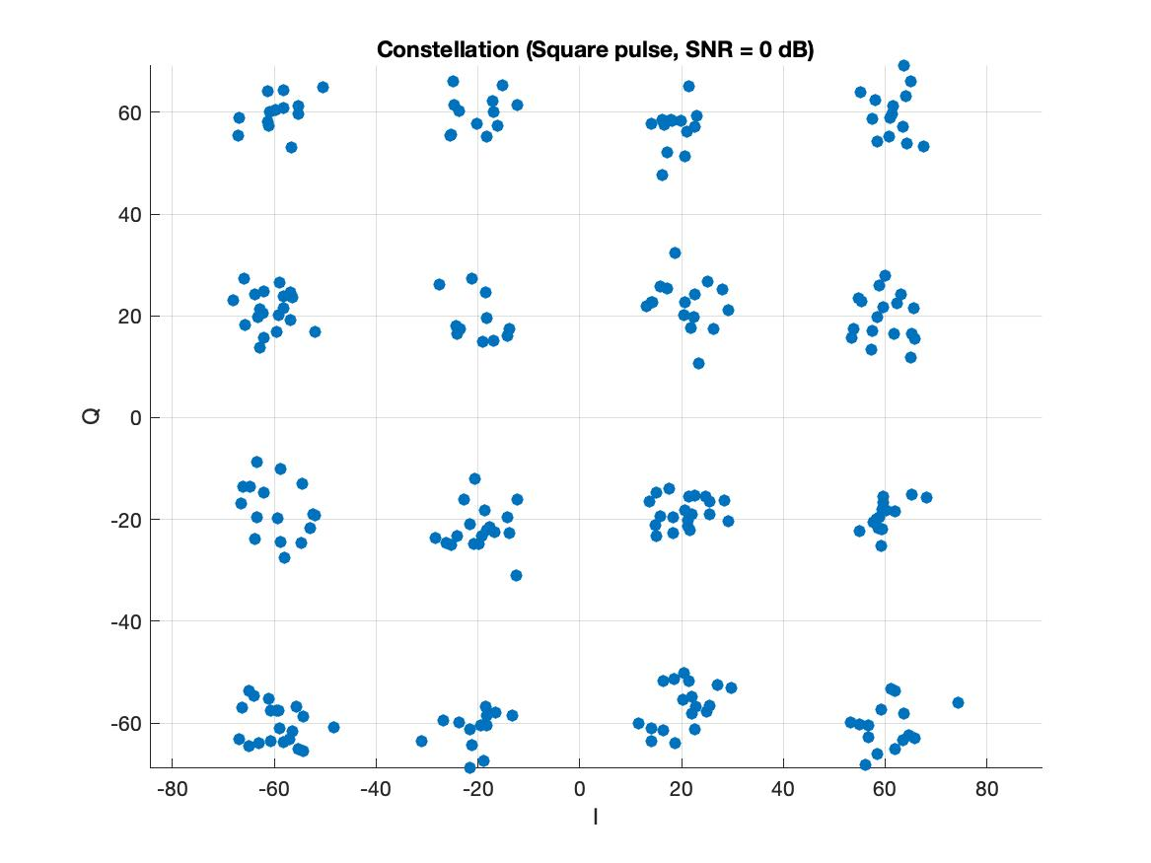
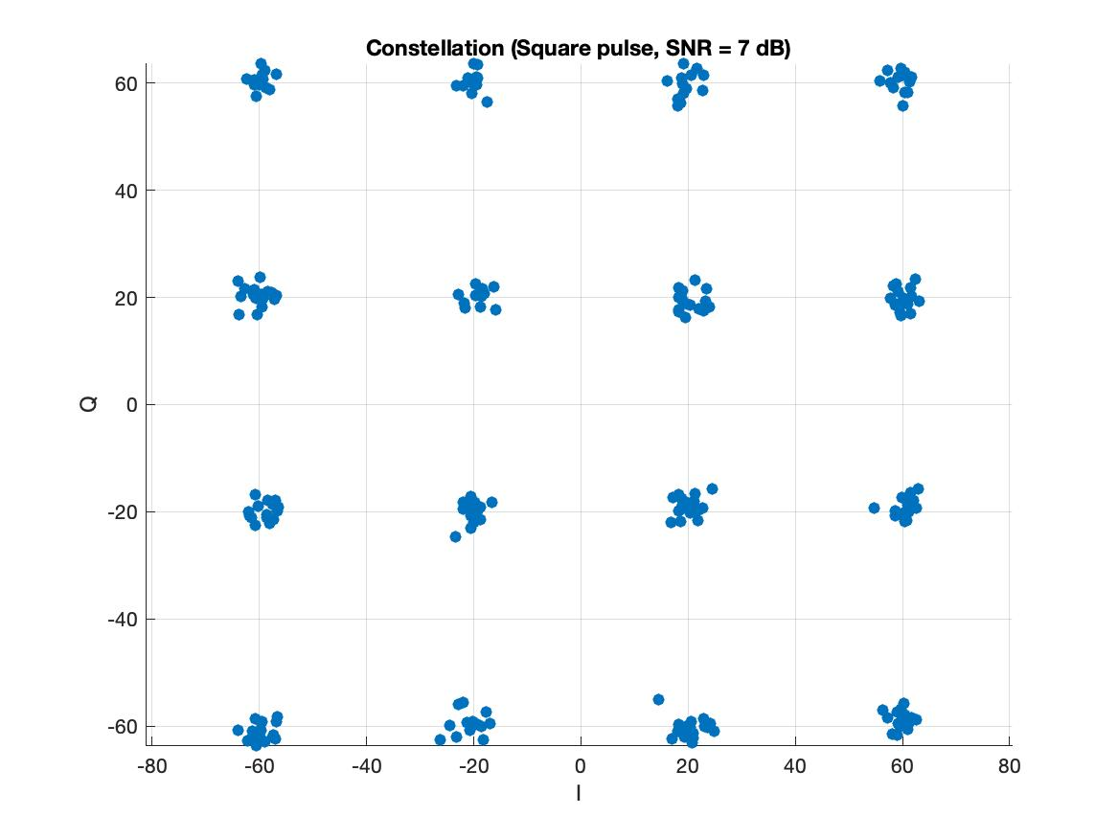
Constellation Diagrams

Slide 6
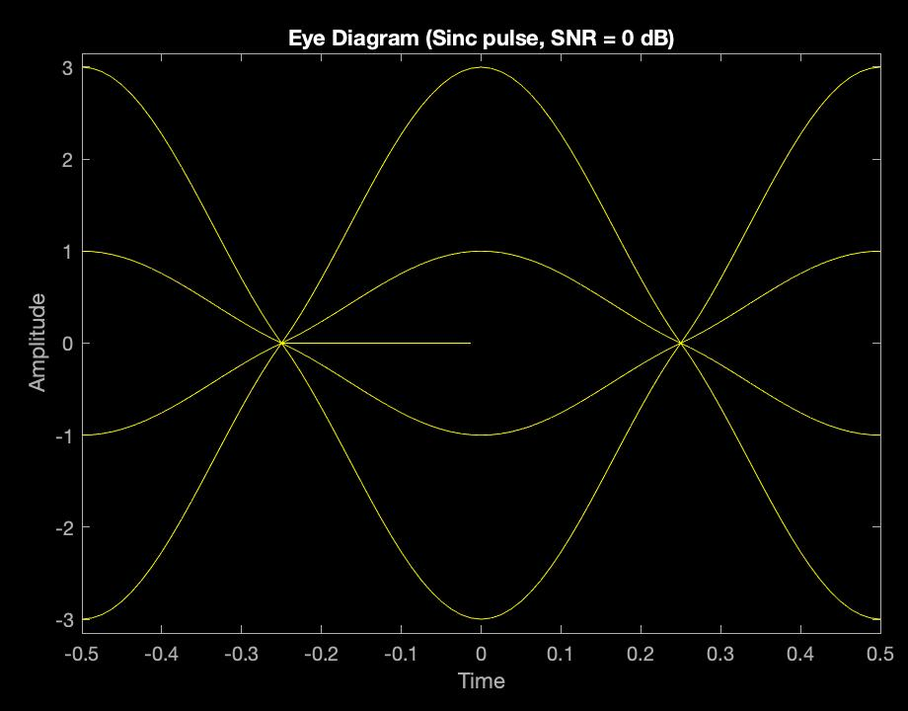
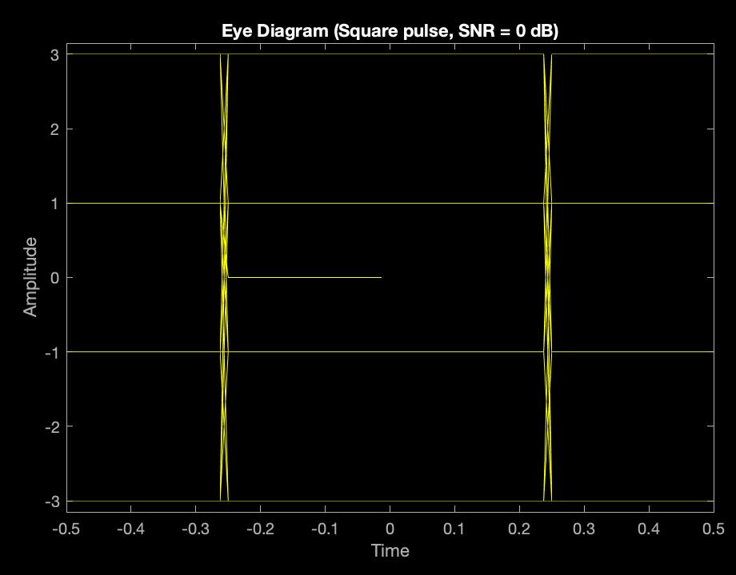
Eye Diagrams

Slide 7
The End

